Slide 1
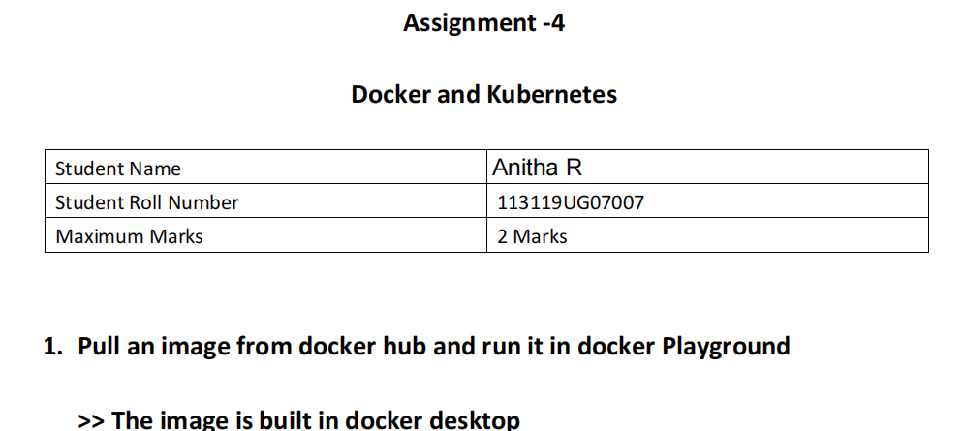

Slide 2
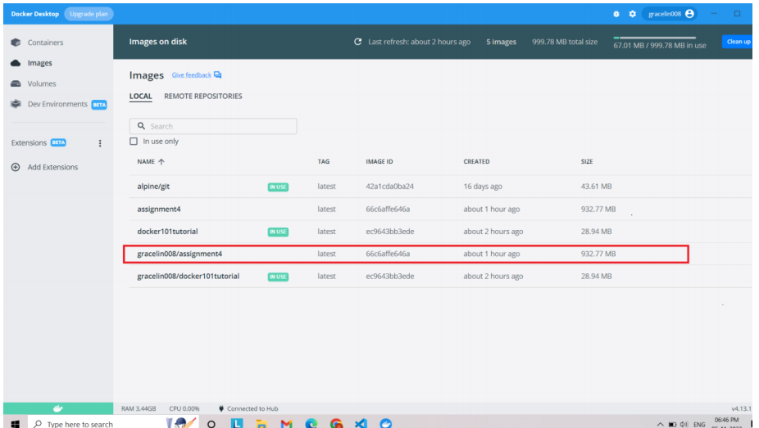
>> Then it is pushed to dockerhub using the command

Slide 3
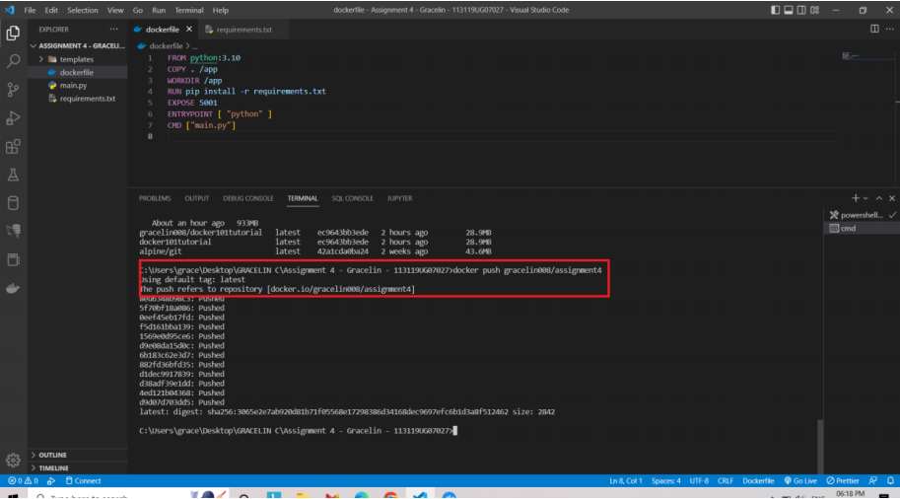
Thus the image named assignment4 is successfully pushed to dockerhub

Slide 4
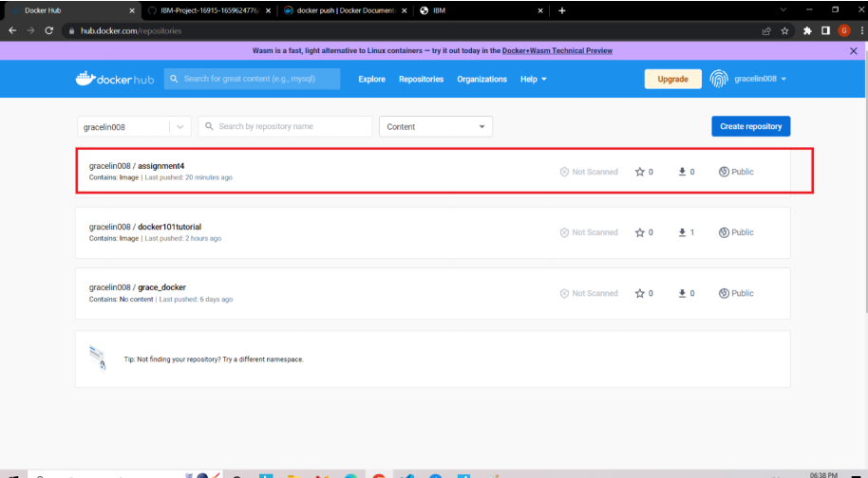

Slide 5
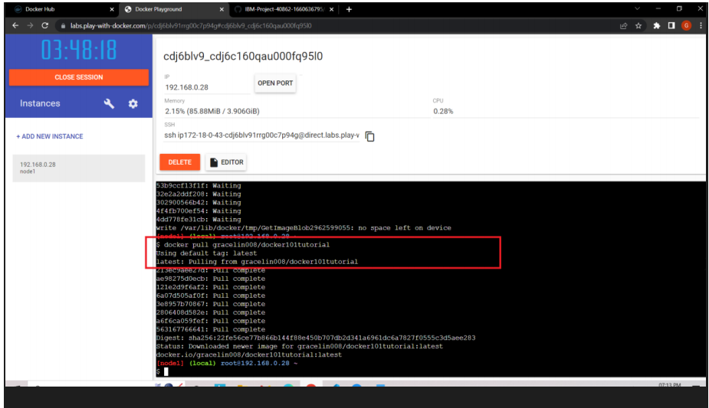
>> Pulled an image from docker hug and ran in dockerplaygound

Slide 6
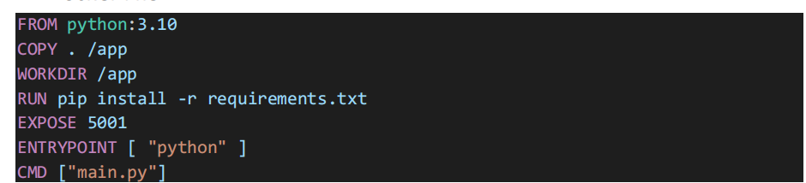
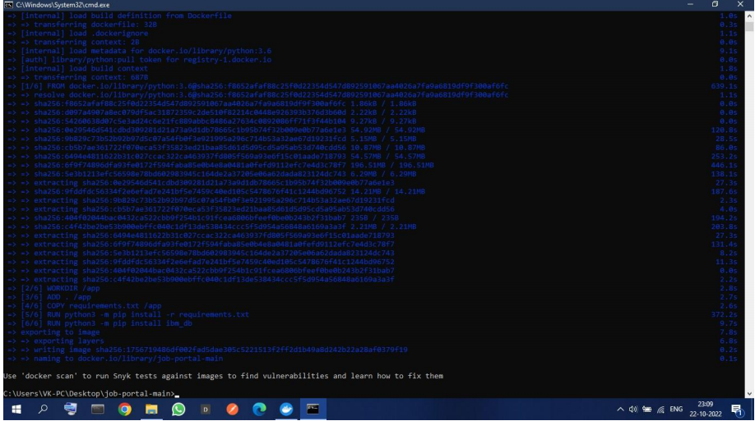
2. Create a docker file for the job portal application and deploy it in Docker desktop application
Docker File
Thus docker file is created

Slide 7
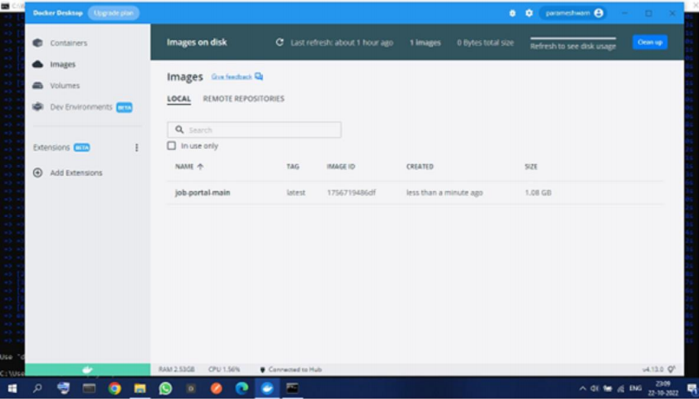
3.Create a IBM container registry and deploy helloworld app
Container registry created using
> docker tag sanoferrasheed/ibmassign4deploy:latest
icr.io/ibmassign4namespace/ibmassign4repo:latest
> docker push icr.io/ibmassign4namespace/ibmassign4repo:latest

Slide 8
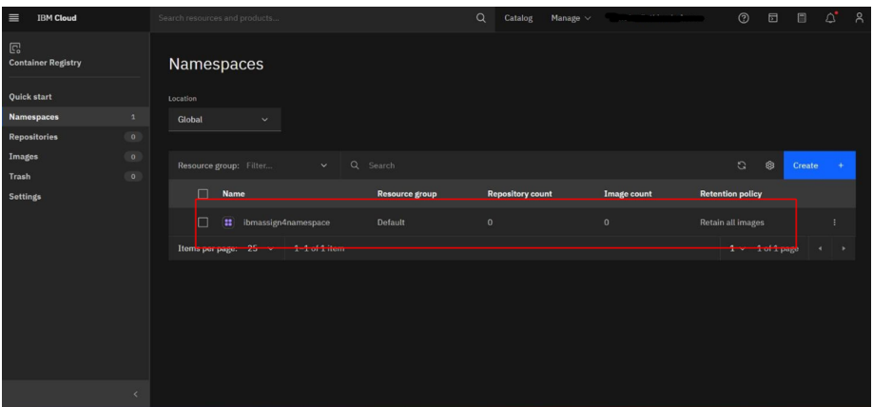
Thus, images in container registry are listed

Slide 9
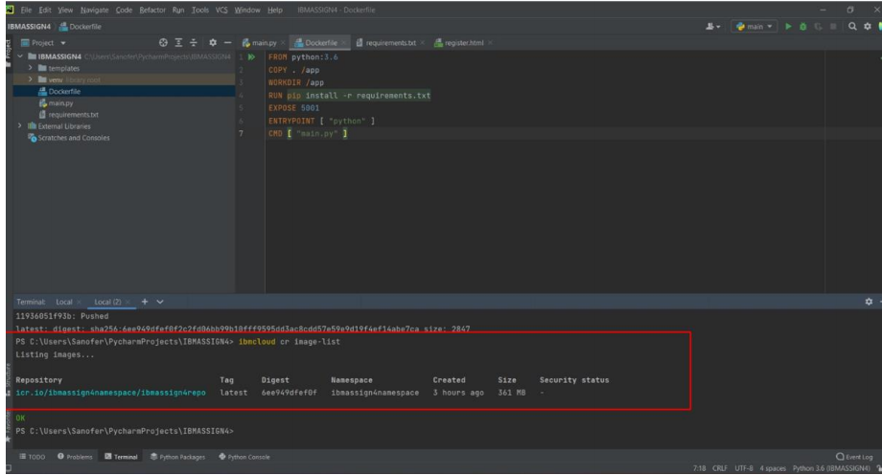
4. Create a Kubernetes cluster in IBM cloud and deploy hello world image
or job portal image and also expose the same app to run in node port.

Slide 11
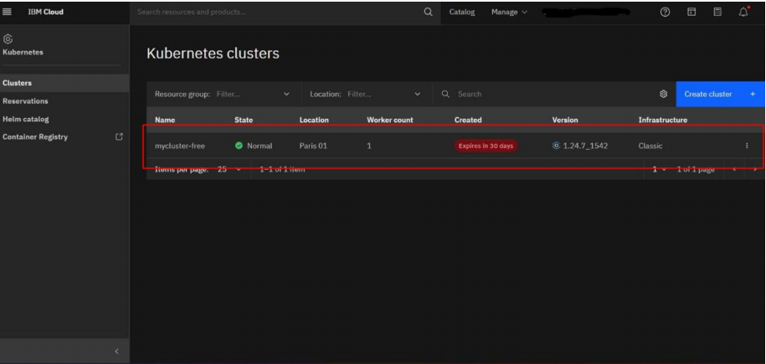
cluster is created

Slide 12
